Slide 1
Retail Digital Supply Chain
Course Introduction
Santiago Gallino, Charles W. Evans Distinguished Faculty Scholar and Assistant Professor of Operations, Information and Decisions

Slide 2
Course Introduction
Focus on understating the main challenges and opportunities that the retailer’s supply chains are seeing today
Revisit the supply chain fundamentals, concentrating on the impact that the digital transformation is having on these fundamentals
Four modules
Digital supply chains
Retail analytics
Retail platforms
Digital transformation in retail

Slide 3
Course Introduction
How meaningful retail analytics can generate value for retailers
What traditional retailers are doing to navigate the digital transformation successfully
The role of digital platforms and how this new business model is disrupting the retail industry

Slide 4
Retail Digital Supply Chain
Supply Chain
Santiago Gallino, Charles W. Evans Distinguished Faculty Scholar and Assistant Professor of Operations, Information and Decisions

Slide 5
Definition
A supply chain is a system of organizations, people, activities, information, and resources involved in supplying a product or service to a consumer
Supply chain activities involve the transformation of natural resources, raw materials, and components into a finished product that is delivered to the end customer

Slide 6
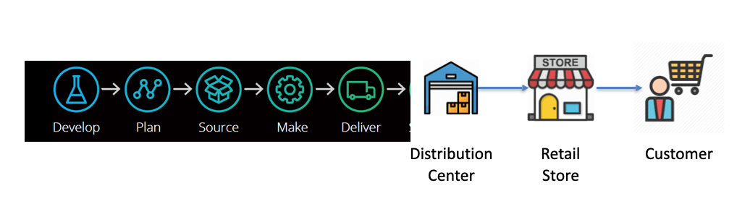
Supply Chain
Deloitte. The Customer-Driven Supply Chain, Digital supply networks enable the whatever-whenever-wherever shopping experience. 2018

Slide 7
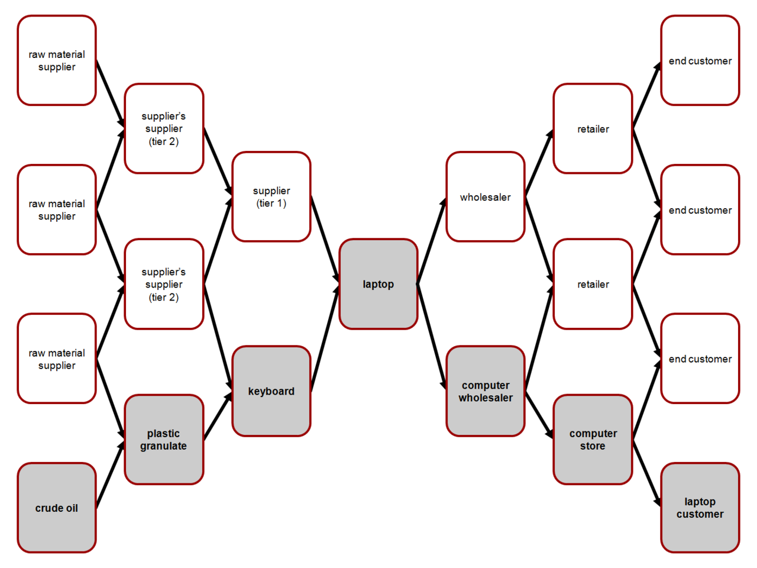
Supply Chain

Slide 8
Supply Chain
What travels in the supply chain?
Goods (products)
Information
Money (payments)

Slide 9
Supply Chain
In what direction do these things travel?
Goods (products)
Returns
For online retailers, this inverse flow of products can be critical
Money (payment)
Payments and credits
Information
Coordination and forecasting
Distortion and the bullwhip effect

Slide 10
Supply Chain
A supply chain is much more than logistics (trucking and warehousing)
All steps are important to keep in mind, and where you need to excel will depend on the type of company that you are running
Companies can focus on different aspects of the supply chain as a strategic advantage against competitors

Slide 11
Retail Digital Supply Chain
What is the Right Supply Chain?
Santiago Gallino, Charles W. Evans Distinguished Faculty Scholar and Assistant Professor of Operations, Information and Decisions

Slide 12
What is the Right Supply Chain?
Understand the characteristics of the product and the customer and supply chain uncertainty
Understand the supply chain capabilities
Evaluating fit

Slide 13
Supply Chain Uncertainty
Want to understand the customer and supply chain uncertainty
Order quantity
Customers tolerance to delays
Variety of products needed
Service level required
Price of the product
Desired rate of innovation in the product

Slide 14
Understanding the Supply Chain Capabilities
Supply chain responsiveness
Allows for a wide range of quantities
Meet short lead times
Handle a large variety of products
Build highly innovative products
Meet a very high service level
Supply chain efficiency
Cost is low, but responsiveness is difficult
Increasing responsiveness results in higher costs that lower efficiency

Slide 15
Understanding the Supply Chain Capabilities
Efficient
Responsive
Primary goal
Lowest cost
Quick response
Pricing strategy
Lower margins
Higher margins
Manufacturing strategy
High utilization
Capacity flexibility
Inventory strategy
Minimize inventory
Buffer inventory

Slide 16
Matching Supply Chain with Products
Products
Functional
Innovative
Efficient
MATCH
MISMATCH
Supply Chain
Responsive
MISMATCH
MATCH

Slide 17
Supply Chain Resilience
Supply chain resilience is the capacity of a supply chain to persist, adapt, and transforms in the face of change
Resiliency comes at a cost

Slide 18
Digital Supply Chain
What is new and why do we need to think of a digital supply chain?
Goods (products)
Complexity has increased
Money (payment)
Electronic payments, new financial institutions and mechanisms
Information
Information richness and sharing speed

Slide 19
Retail Digital Supply Chain
Retail Digital Supply Chain
Santiago Gallino, Charles W. Evans Distinguished Faculty Scholar and Assistant Professor of Operations, Information and Decisions

Slide 20
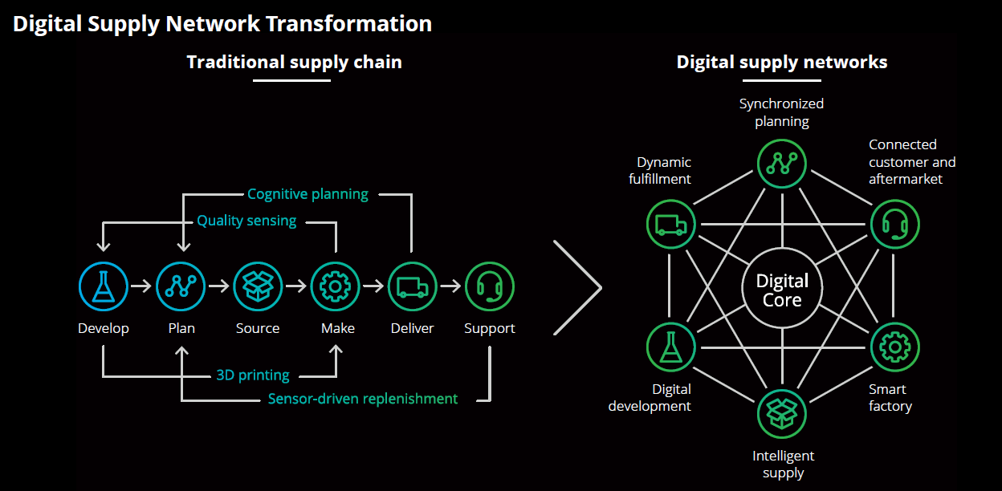
Retail Digital Supply Chain
Deloitte. The Customer-Driven Supply Chain, Digital supply networks enable the whatever-whenever-wherever shopping experience. 2018

Slide 21
Retail Supply Chain Disruptions
E-commerce retail
Changes to traditional inventory/product flow
Information flow quicker and more complex
3rd party logistics
Role of manufacturers
Definition of what a retailer is has blurred

Slide 22
Retail Digital Supply Chain
Digital Capabilities
Santiago Gallino, Charles W. Evans Distinguished Faculty Scholar and Assistant Professor of Operations, Information and Decisions

Slide 23
Foundational Capabilities
Capabilities that any retailer needs to have today, in order to navigate the digital transformation successfully
Where you can start building other, more specific capabilities to your business that can help in successfully differentiating from other companies that are doing this digital transformation process

Slide 24
Foundational Capabilities
Advanced analytics

Slide 25
Foundational Capabilities
Advanced analytics
Smart forecasting
Not only making the forecast of my own needs, but also what is going to happen all across the supply chain

Slide 26
Foundational Capabilities
Advanced analytics
Smart forecasting
Network visibility
In the past, the goal was to map the supply chain, to know your set of suppliers
Today, that may not be enough — need to be aware of the suppliers of your suppliers, moving one step back in the supply chain
The same is true going forward in the supply chain — from the buying point, you want to have visibility on where the inventory is going to be placed

Slide 27
Foundational Capabilities
Advanced analytics
Smart forecasting
Network visibility
Dynamic connectivity
Your other foundational capabilities will not be as helpful if you do not have good connectivity between the different nodes
Will help with out-of-stocks, increase the service level, and make strategic changes that will allow you to compete in a more effective way

Slide 28
Foundational Capabilities
Advanced analytics
Smart forecasting
Network visibility
Dynamic connectivity

Slide 29
Business Specific Capabilities
Advanced capabilities are generally more complex or are dependent on foundational capabilities and how well those have been incorporated
Order fulfillment optimization
Capability that will allow you to have the possibility to place orders as fast as the demand signal is received
Going to suggest where in the supply chain you want to place the inventory
Will allow you to minimize the total investment in inventory while keep the service level as high as possible

Slide 30
Business Specific Capabilities
Advanced capabilities are generally more complex or are dependent on foundational capabilities and how well those have been incorporated
Order fulfillment optimization
Delivery optimization
Dynamic workforce management
Cross-channel returns management

Slide 31


